Slide 1
I/O Systems Lesson 5 Performance
David Liu
Fall 2021, Spring 2022

Slide 2
Performance
I/O a major factor in system performance:
Demands CPU to execute device driver, kernel I/O code
Context switches due to interrupts
Data copying
Network traffic especially stressful

Slide 3
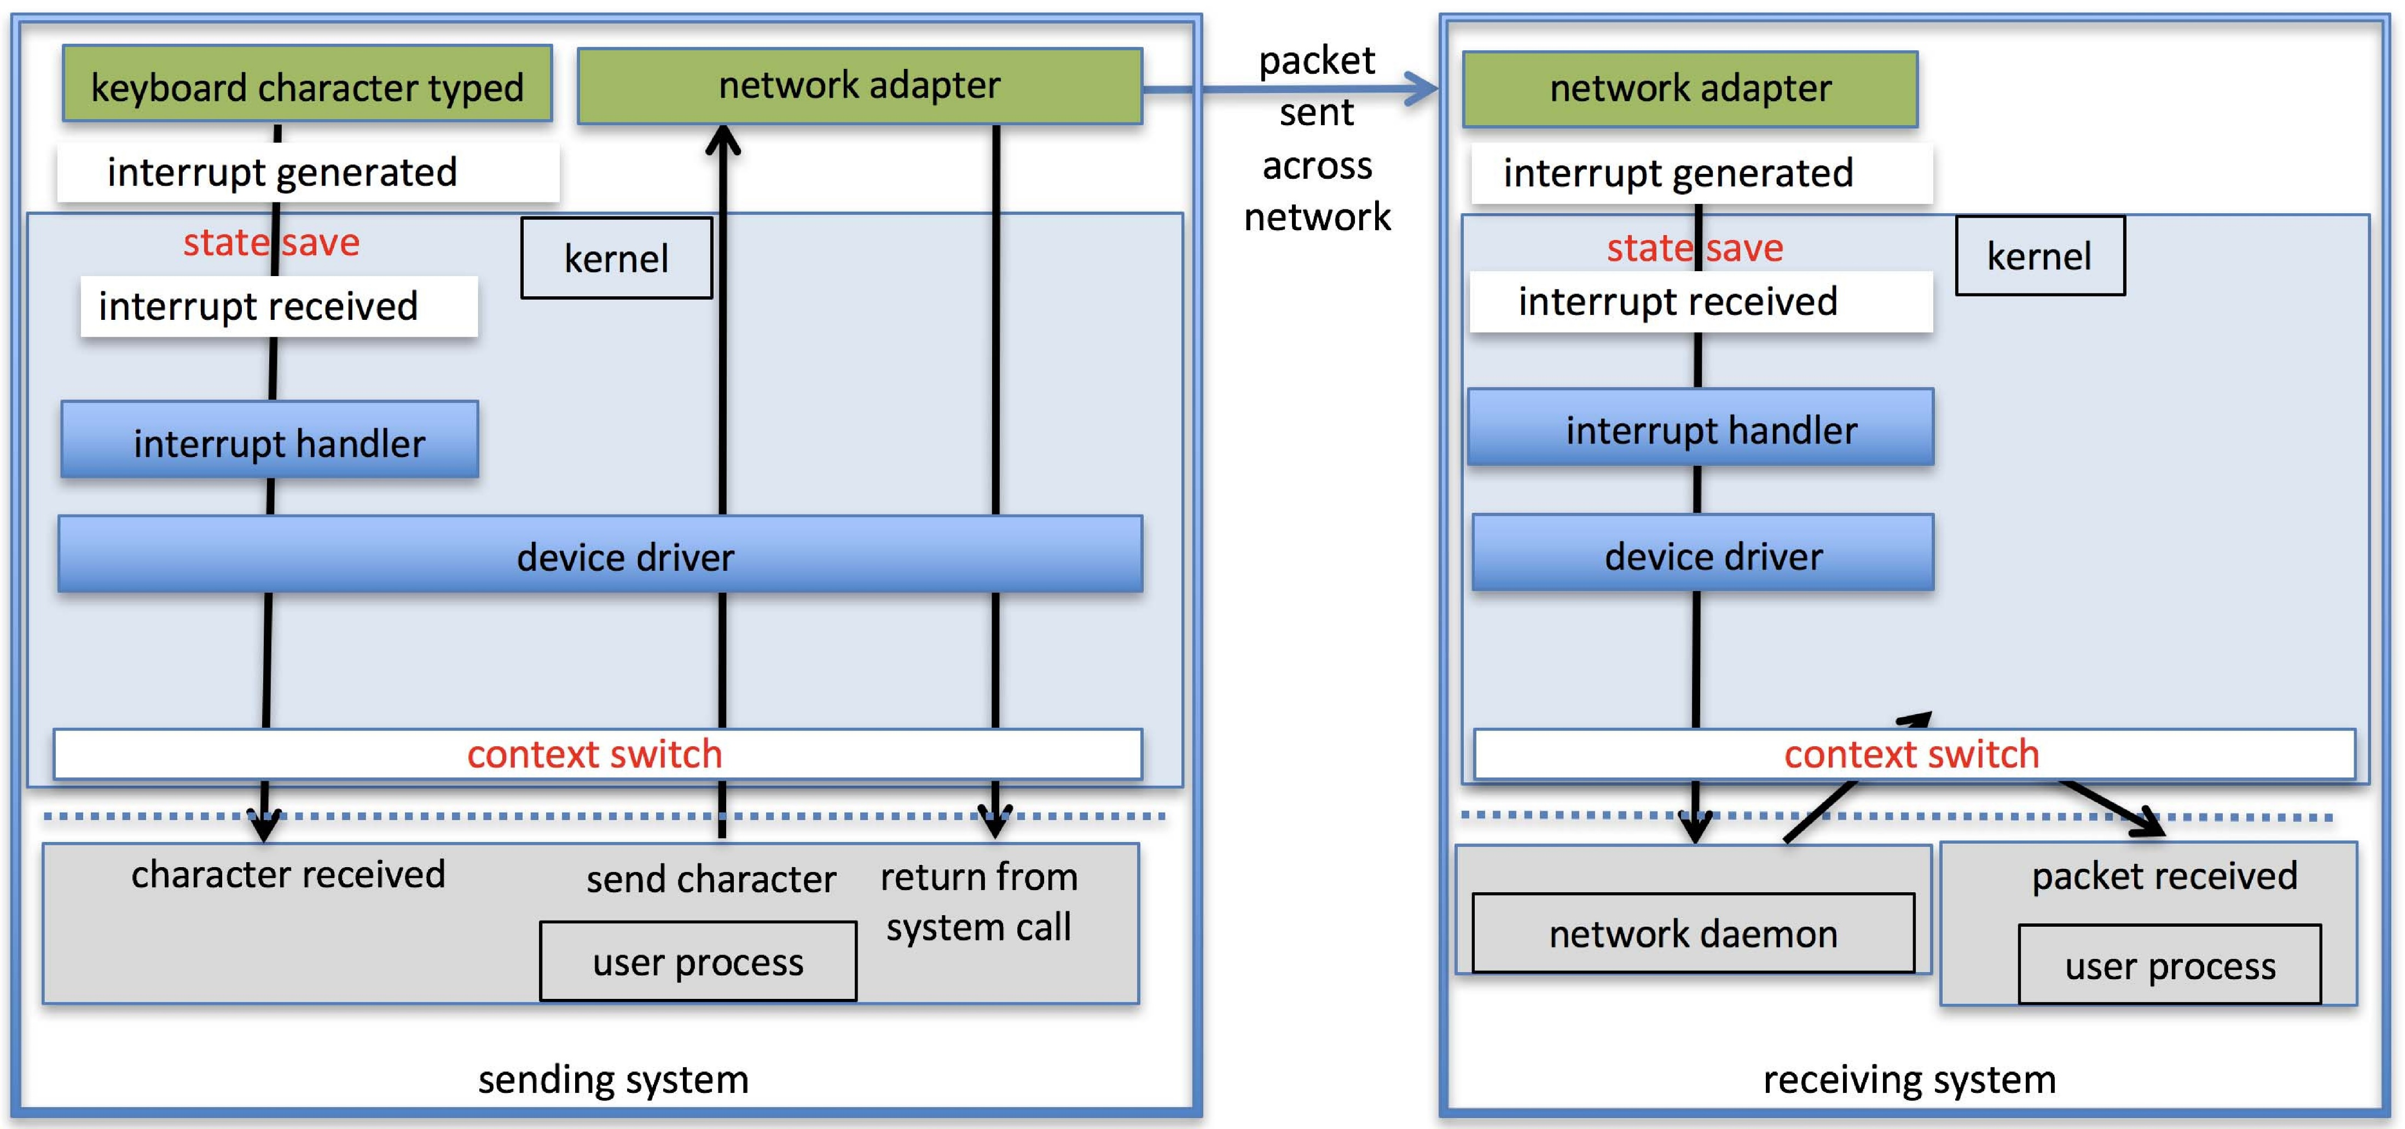
Intercomputer Communications

Slide 4
Improving Performance
Reduce number of context switches
Reduce data copying
Reduce interrupts by using large transfers, smart controllers, polling
Use DMA
Use smarter hardware devices
Balance CPU, memory, bus, and I/O performance for highest throughput
Move user-mode processes / daemons to kernel threads

Slide 5
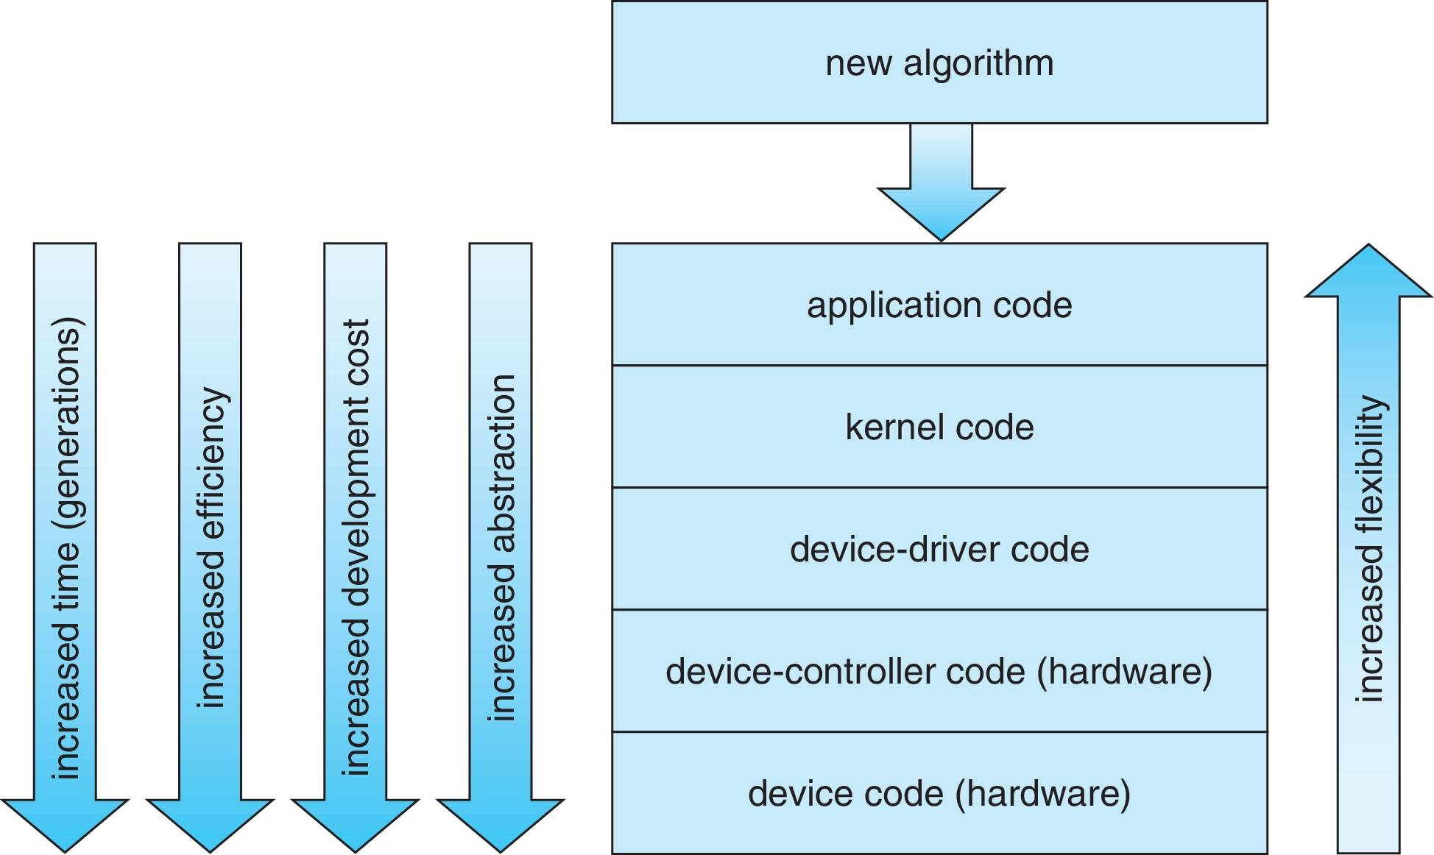
Device-Functionality Progression

Slide 6
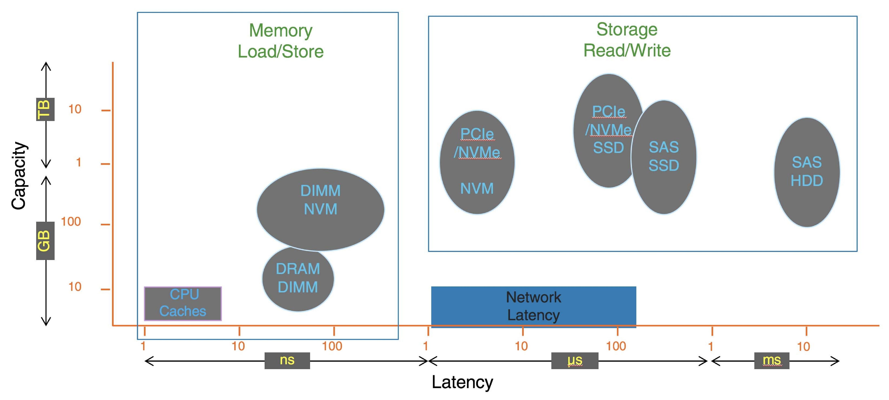
I/O Performance of Storage (and Network Latency)

